Slide 1
Wireless LANs

Slide 2
15.15.1 Architectural Comparison
Let us first compare the architecture of wired and wireless LANs to give some idea of what we need to look for when we study wireless LANs.
15.<number>
Notes:
15.#

Slide 3
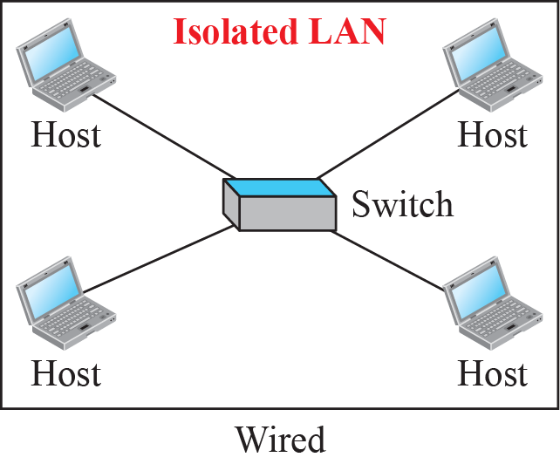
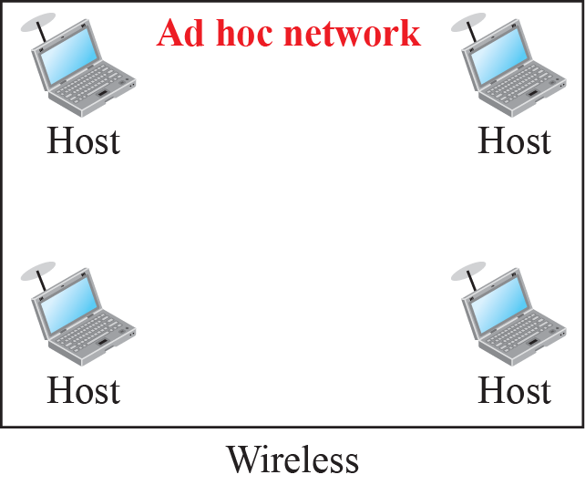
Figure 15.1: Isolated LANs: wired versus wireless
15.<number>
Notes:
15.#

Slide 4
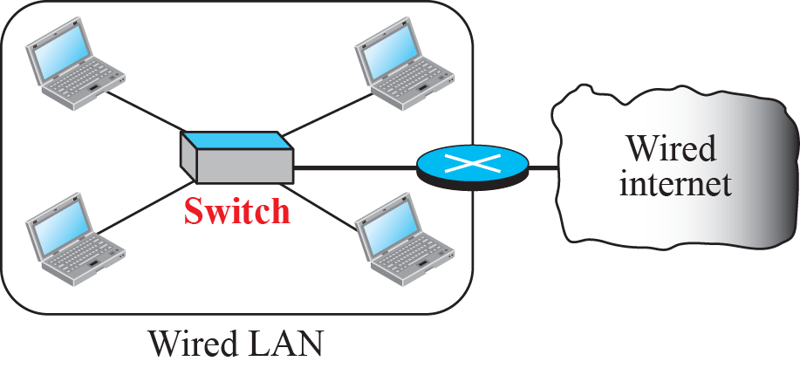
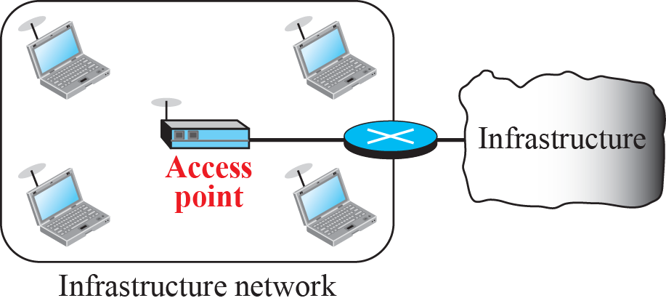
Figure 15.2: Connection of a wired LAN and a wireless LAN to other
networks
15.<number>
Notes:
15.#

Slide 5
15.15.2 Characteristics
There are several characteristics of wireless LANs that either do not apply to wired LANs or the existence of which is negligible and can be ignored. These characteristics pave the way for discussing wireless LAN protocols
1.Attenuation
2.Interference
3.Multipath propagation
4.Error
15.<number>
Notes:
15.#

Slide 6
15.15.3 Access Control
Maybe the most important issue we need to discuss in a wireless LAN is access control—how a wireless host can get access to the shared medium (air). The CSMA/CD algorithm does not work in wireless LANs for three reasons:
Wireless hosts do not have enough power to send and receive at the same time.
The hidden station problem prevents collision detection
The distance between stations can be great.
15.<number>
Notes:
15.#

Slide 7
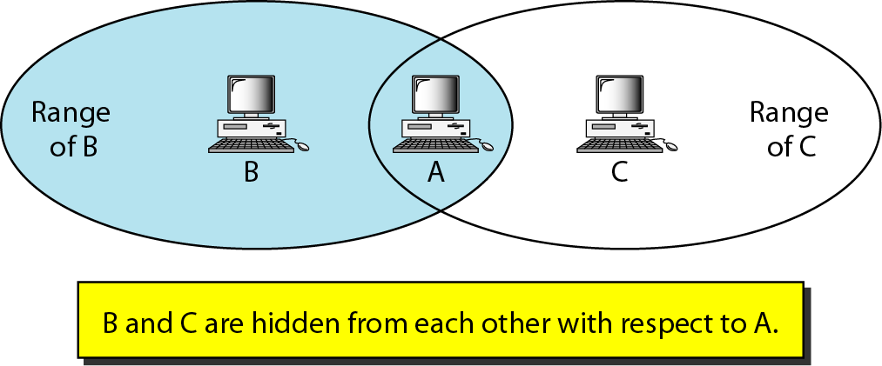
Figure 14.10 Hidden station problem
14.<number>

Slide 8
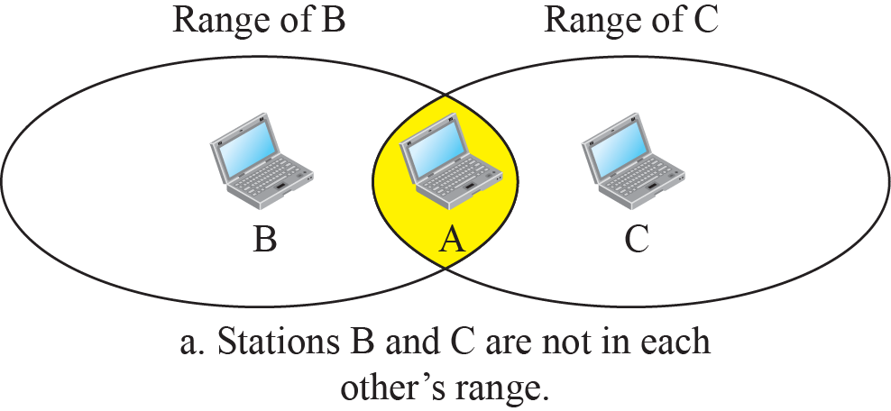
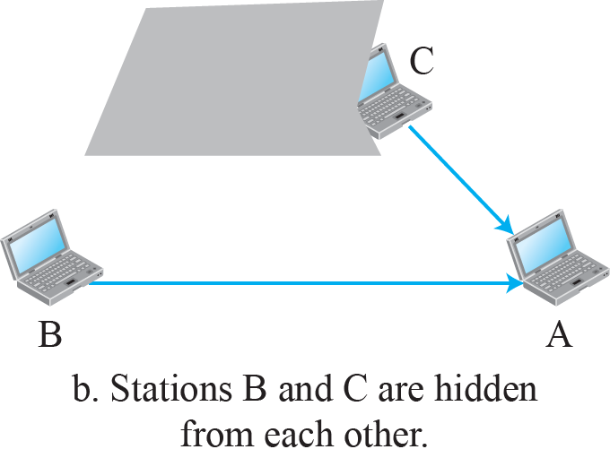
Figure 15.3: Hidden station problem
15.<number>
Notes:
15.#

Slide 9
15.2.1 Architecture
The standard defines two kinds of services: the basic service set (BSS) and the extended service set (ESS).
15.<number>
Notes:
15.#

Slide 10
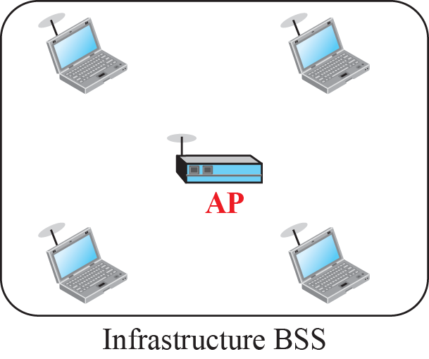
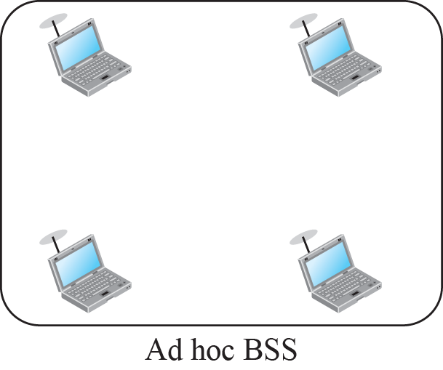
Figure 15.4: Basic service sets (BSSs)
15.<number>
Notes:
15.#

Slide 11
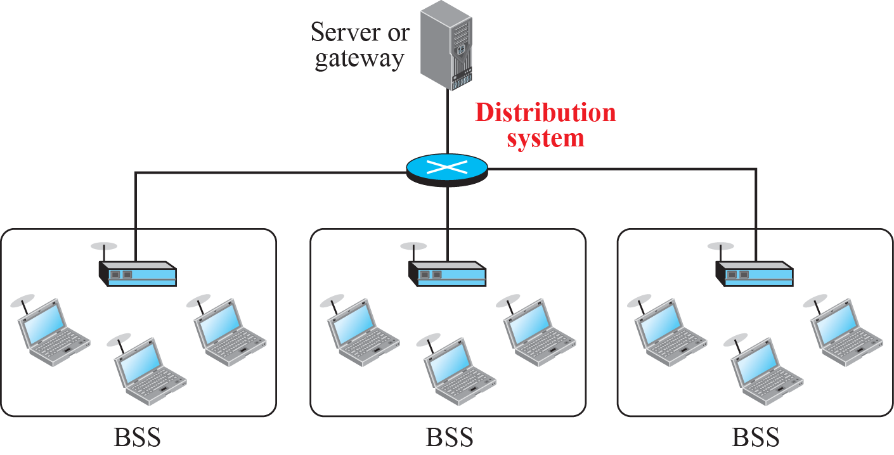
Figure 15.6: Extended service set (ESS)
15.<number>
Notes:
15.#

Slide 12
15.2.2 MAC Sublayer
IEEE 802.11 defines two MAC sublayers: the distributed coordination function (DCF) and point coordination function (PCF). Figure 15.6 shows the relationship between the two MAC sublayers, the LLC sublayer, and the physical layer. We discuss the physical layer implementations later in the chapter and will now concentrate on the MAC sublayer.
15.<number>
Notes:
15.#

Slide 13
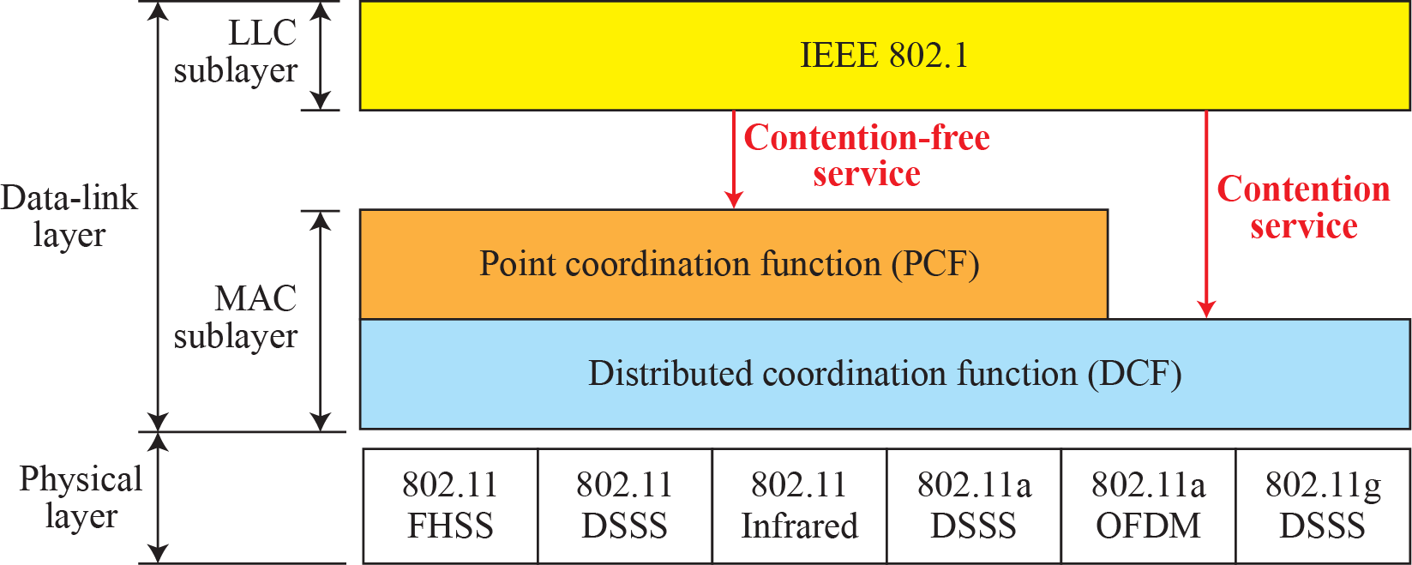
Figure 15.6: MAC layers in IEEE 802.11 standard
15.<number>
Notes:
15.#

Slide 14













Figure 15.7: CSMA/CA and NAV
15.<number>
Notes:
15.#

Slide 15
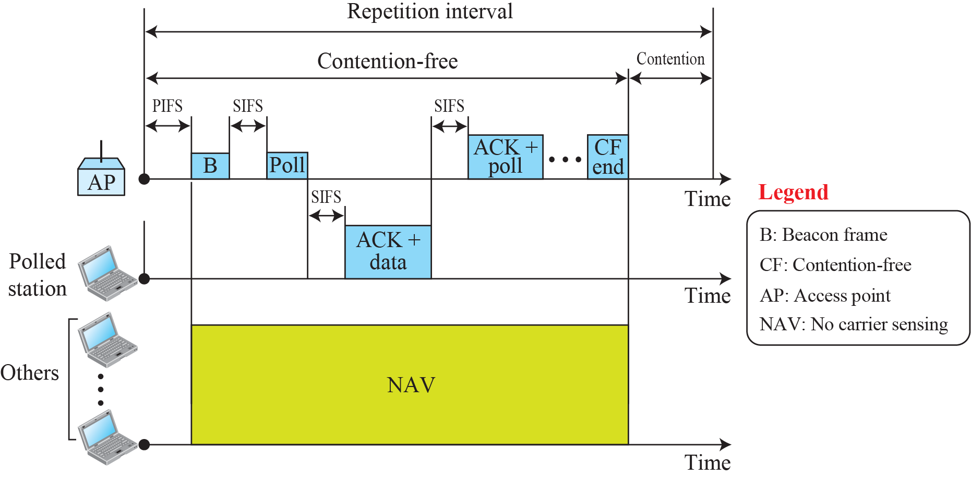
Figure 15.8: Example of repetition interval
15.<number>
Notes:
15.#

Slide 16

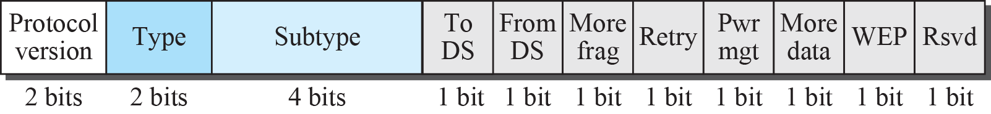
Figure 15.9: Frame format
15.<number>
Notes:
15.#

Slide 17

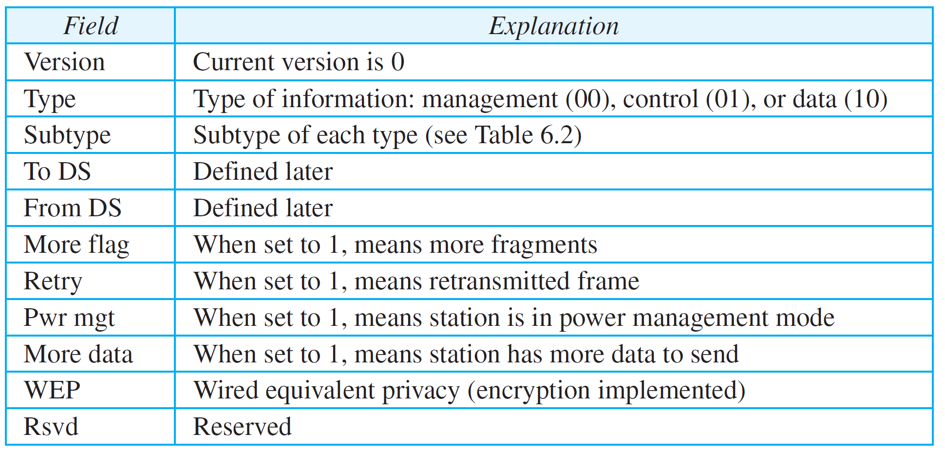
Table 15.1: Subfields in FC field
15.<number>

Slide 18
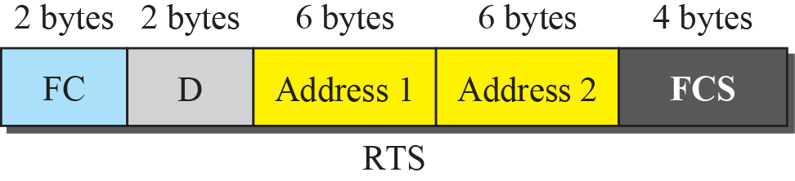
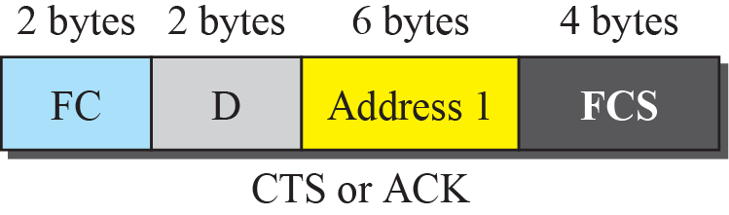
Figure 15.10: Control frames
15.<number>
Notes:
15.#

Slide 19
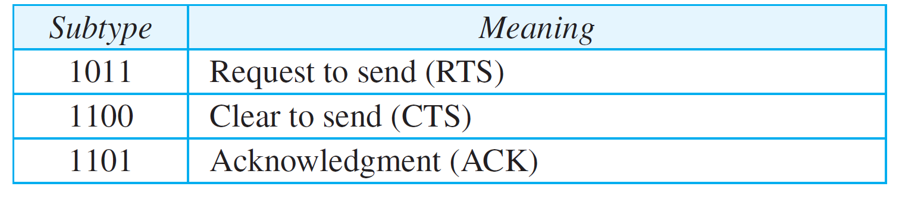
Table 15.2: Values of subfields in control frames
15.<number>

Slide 20
15.2.3 Addressing Mechanism
The IEEE 802.11 addressing mechanism specifies four cases, defined by the value of the two flags in the FC field, To DS and From DS. Each flag can be either 0 or 1, resulting in four different situations. The interpretation of the four addresses (address 1 to address 4) in the MAC frame depends on the value of these flags, as shown in Table 15.3.
15.<number>
Notes:
15.#

Slide 21
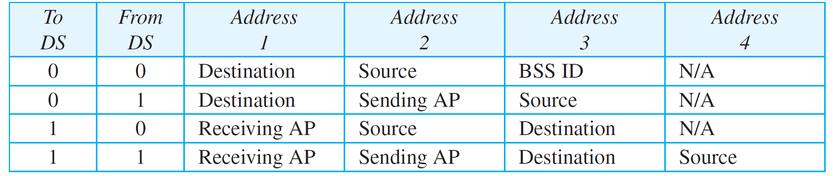
Table 15.3: Addresses
15.<number>

Slide 22
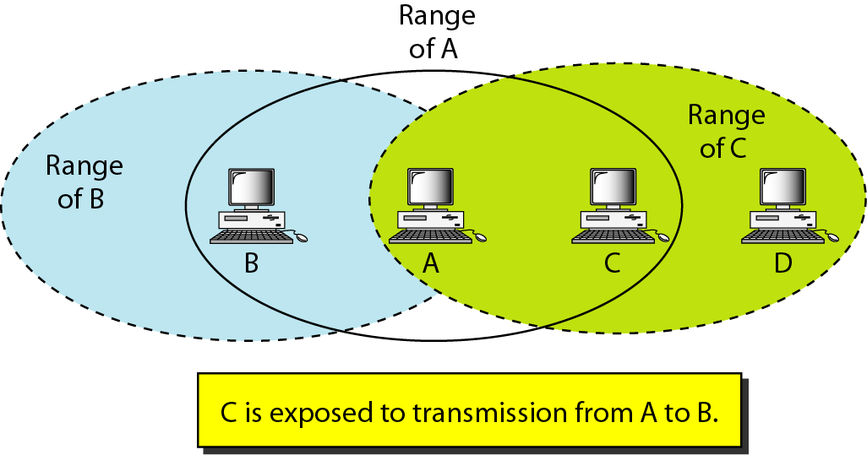
Figure 14.12 Exposed station problem
14.<number>

Slide 23
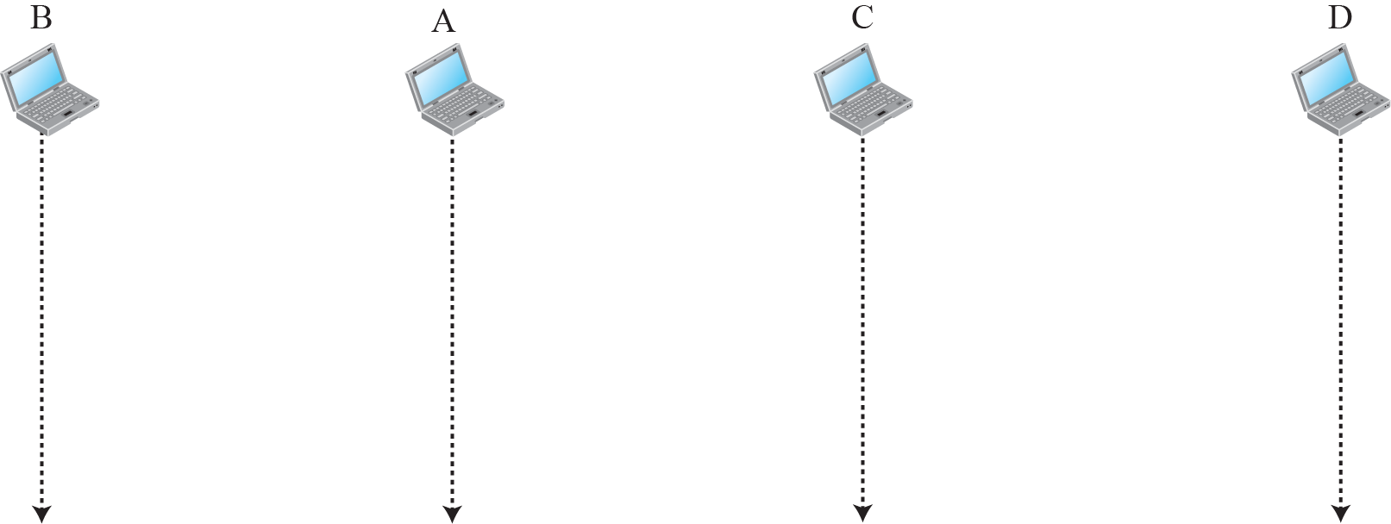
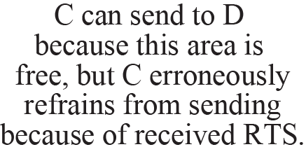


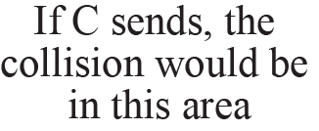
Figure 15.12: Exposed station problem
15.<number>
Notes:
15.#

Slide 24
15.2.4 Physical Layer
We discuss six specifications, as shown in Table 15.4. All implementations, except the infrared, operate in the industrial, scientific, and medical (ISM) band, which defines three unlicensed bands in the three ranges 902–928 MHz, 2.400–4.835 GHz, and 5.725–5.850 GHz.
15.<number>
Notes:
15.#

Slide 25
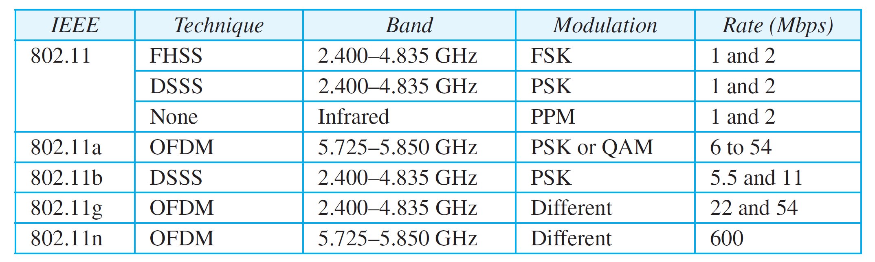
Table 15.4: Specifications
15.<number>

Slide 26
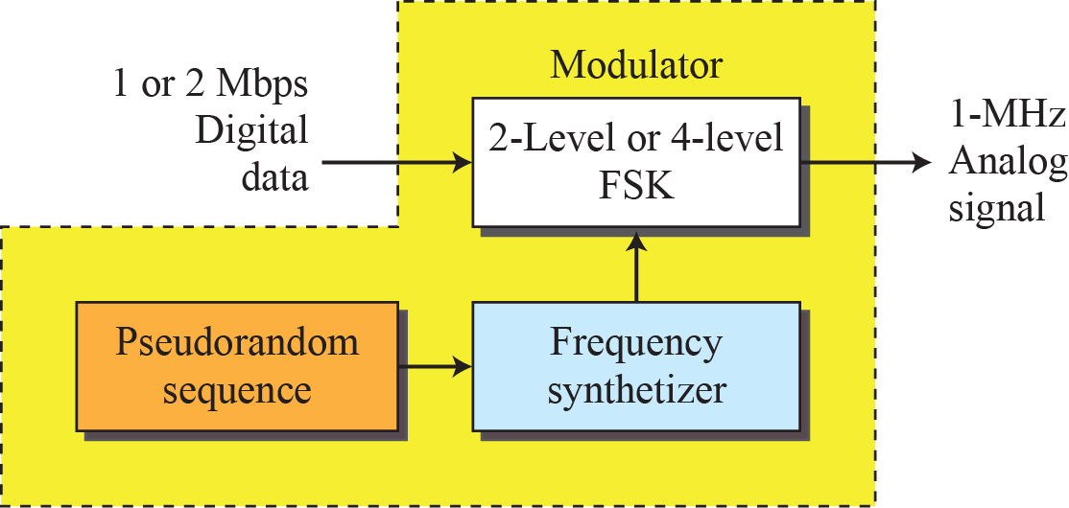
Figure 15.13: Physical layer of IEEE 802.11 FHSS
15.<number>
Notes:
15.#

Slide 27
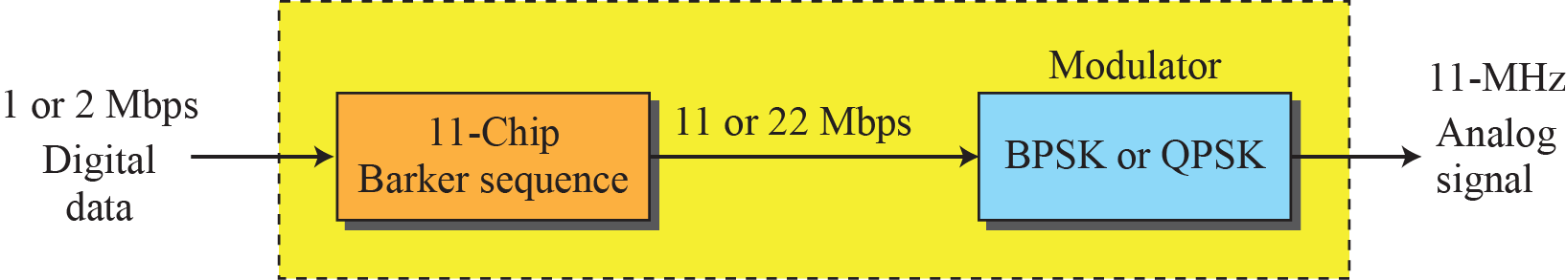
Figure 15.14: Physical layer of IEEE 802.11 DSSS
15.<number>
Notes:
15.#

Slide 28
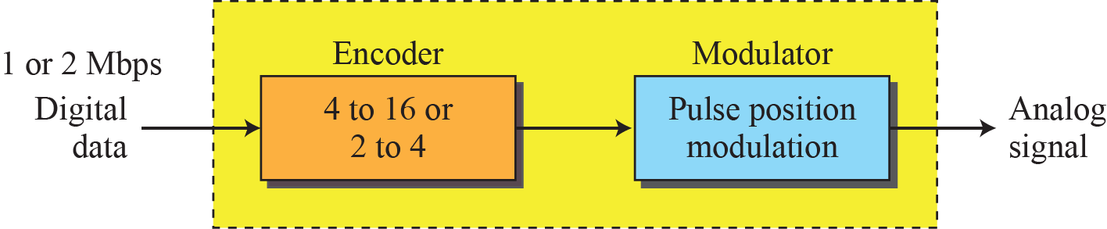
Figure 15.15: Physical layer of IEEE 802.11 infrared
15.<number>
Notes:
15.#

Slide 29
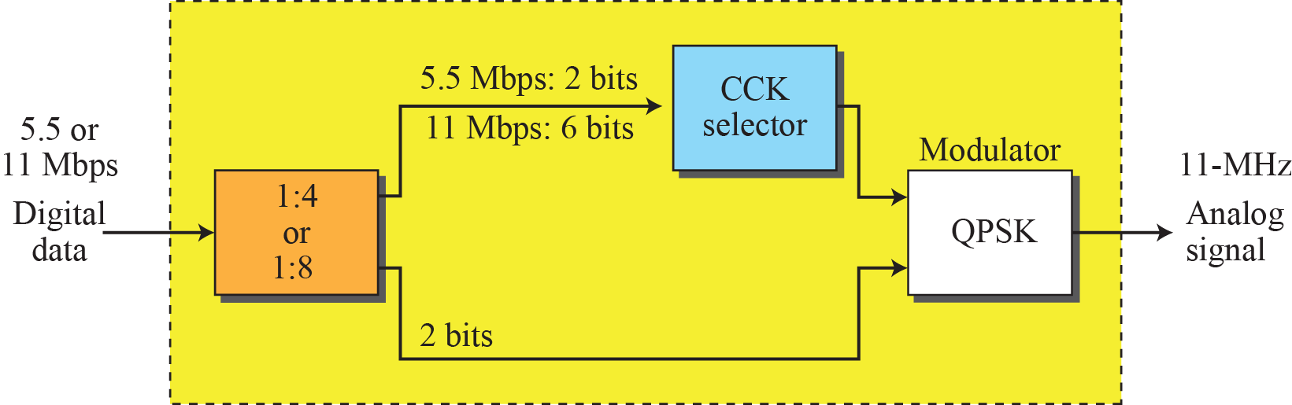
Figure 15.16: Physical layer of IEEE 802.11b
15.<number>
Notes:
15.#

